Slide 1



Wireless Sensor Networks
Craig Ulmer

Slide 2
Background: Sensor Networks
Array of Sensor Probes (10-1000)
Collect In-Situ Data about Environment
Wireless Links
  Relay Data
  Collaboration

Slide 3


NASA Applications
Primary
  In-Situ Data Collection
  Precision Landing Guidance
  Vehicle Health Sensors
Secondary
  Trail Markers
  Relay Networks

Slide 4
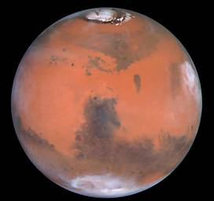
Motivating Application:
Exploration of Mars
Scientific Phenomena:
  Thermal Currents
  Dust Storms
  Seismology
Engineering Challenge:
  No GPS
  No Communication Infrastructure
  Size, Mass, & Power Constraints

Slide 5
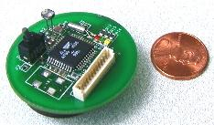
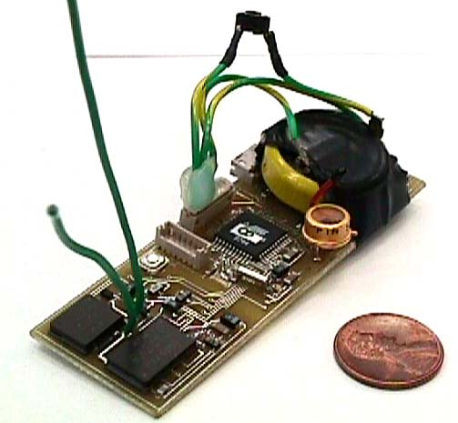
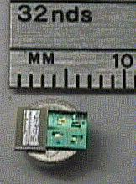
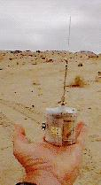
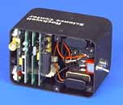
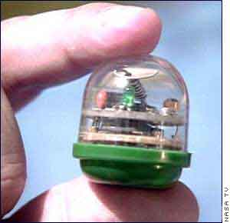
Modern Sensor Nodes
UC Berkeley: COTS Dust
UC Berkeley: Smart Dust
UC Berkeley: COTS Dust
UCLA: WINS
Rockwell: WINS
JPL: Sensor Webs

Slide 6
Node Hardware
1Kbps - 1Mbps,
3-100 Meters,
Lossy Transmissions
128KB-1MB
Limited Storage
Transceiver
Memory
Embedded
Processor
8-bit, 10 MHz
Slow Computations
Sensors
66% of Total Cost
Requires Supervision
Battery
Limited Lifetime

Slide 7
Networking
Multi-Hop Routing
  Limited Transmission Range
Routing Issues:
  Irregular Topologies – Data Transport Aware
  Power Aware – Fault Tolerant

Slide 8
Scientific Value
Multiple Data Points: Time and Position
Temporal Synchronization
  Hierarchical Schemes
Position Estimation
  Digital Ranging
  Offline Triangulation
d₁
d₃
φ
d₂

Slide 9
Sensor Network Initialization
Deploy
Wake/Diagnosis
Organize into Clusters
Route

Slide 10
SensorSim
Sensor Network Simulator
  How well do Algorithms Perform?
  Algorithms as State Machines
Configurable Modules for Flexibility
  Simulation at Different Levels
Java Based
  Platform Independent

Slide 11
Simulator Node Layers
Sensor
Triggers
Application
Data Fusion
Clock Synchronization
Routing
Clustering Algorithms,
Reliable Routing
Link
Medium Access,
Commercial Chipsets
Node

Slide 12
Example: Election Clustering
Distributed Algorithm
Nodes Elect Leaders, Form Groups
Limited Knowledge
Undecided
Trial
Member
Trial
Leader
Member
Leader
Join
Nearest

Slide 13
Example: Fixed Leader Clustering
Predefined Cluster Leaders
Find Nearest Leader
“Mutiny” if Leader too
Far Away
Sleep
Undecided
Leader
Member

Slide 14
Other Simulators
ns
  CMU Monarch Extensions for Ad Hoc Wireless
  WiNS: Wireless Network Simulator
  LEACH/PEGASIS Extensions to WiNS
GloMoSim / UCLA
Opnet

Slide 15
Why Another Simulator?
Previous Sims: LAN-Biased
  Assume Thick Layers (802.11,TCP, Telnet)
  End-to-End Networking
Sensor Nets: Different Architecture
  How Can We Network w/ Minimal Hardware?
  Interested in Node Behavior
  Adapting Other Sims is Same Job

Slide 16
Ongoing Work: Network Algorithms
Given Clusters, How do we Route?
  Limited Route Table Storage
  Traffic Often Directed
  Loop-Free
  Minimal Route Updates
How does Node know Location in Network?
  “Identifying ID” Number

Slide 17
Sunrise Synchronization
Use Sunrise as Synchronization Point
  Earlier Risers are More Eastern
  Smooth with Cluster Values, Neighbor Clusters
Gross Estimate of East-West Dimension

Slide 18
Conclusions
Sensor Networks Valuable Collection Agents
Minimal Hardware, Adapt Algorithms to Match
Use Scientific Observations in Routing
SensorSim Ongoing Work for Analysis

